Slide 1
Hadoop
Basics

Slide 2
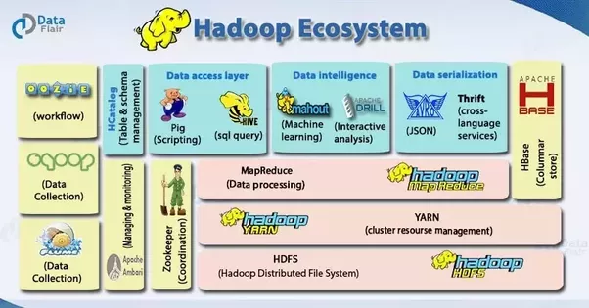

Slide 3
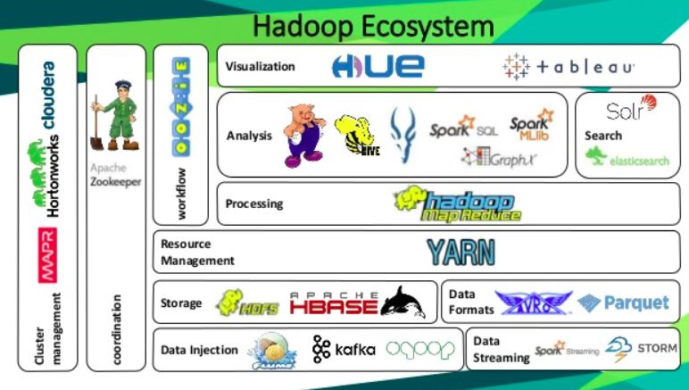

Slide 4
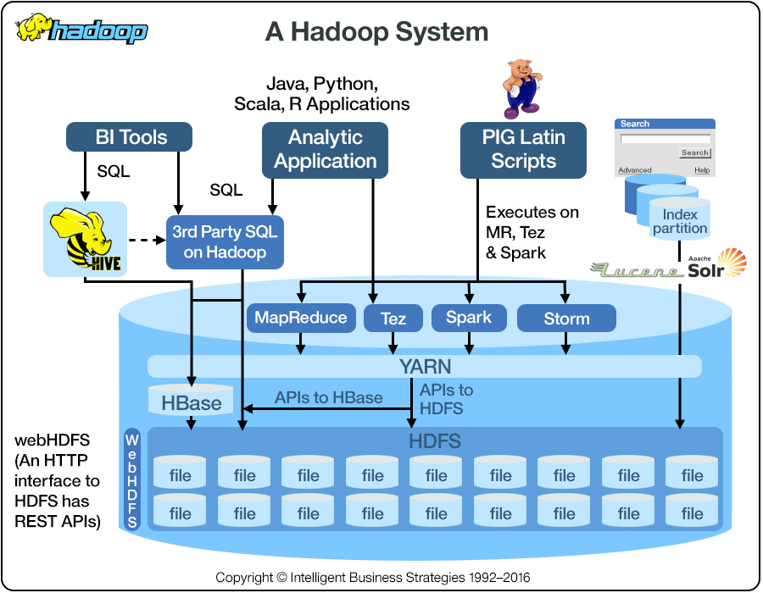

Slide 5
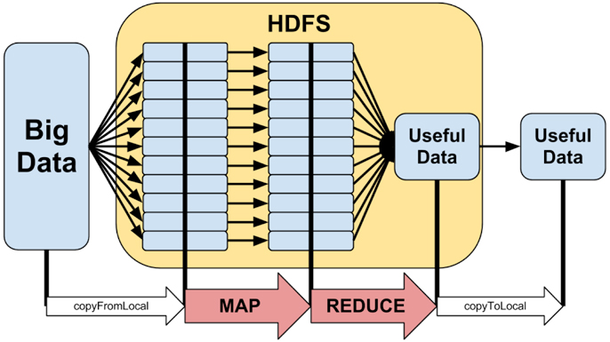

Slide 6
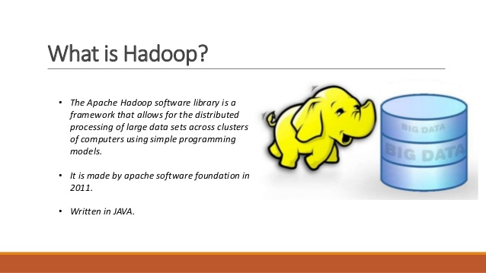

Slide 7


Slide 8
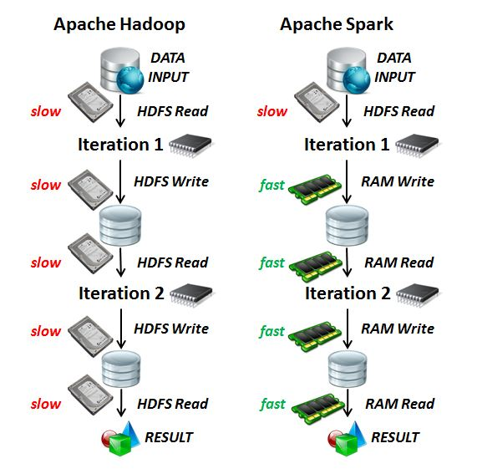

Slide 9
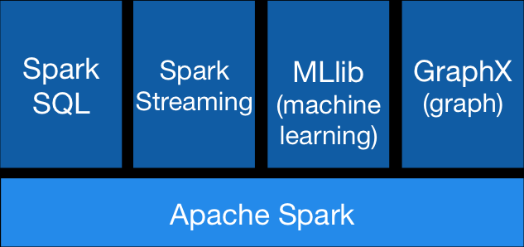
Spark

Slide 10
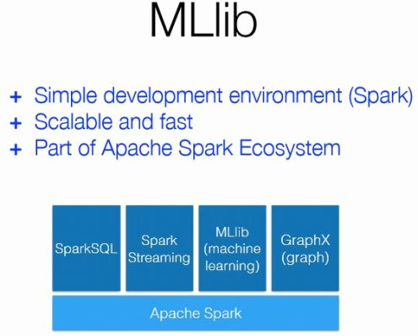

Slide 11
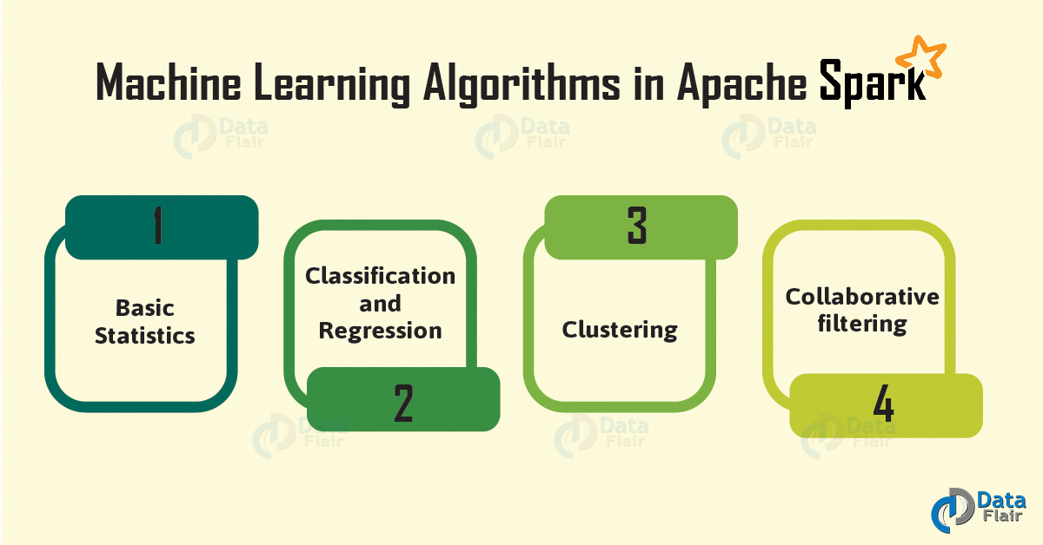

Slide 12
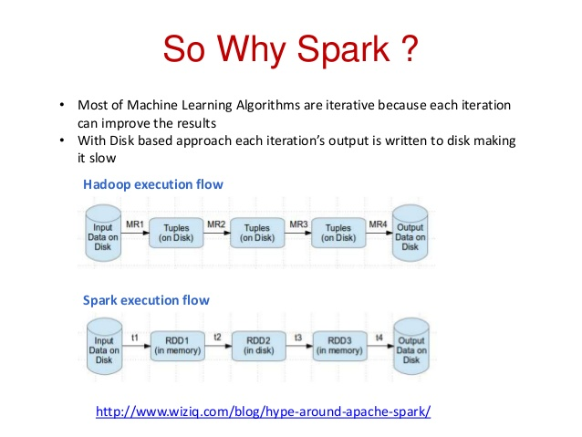

Slide 13
Apache Spark as a
fast and general engine for big data processing,
with built-in modules for
streaming,
SQL,
machine learning
graph processing.

Slide 14
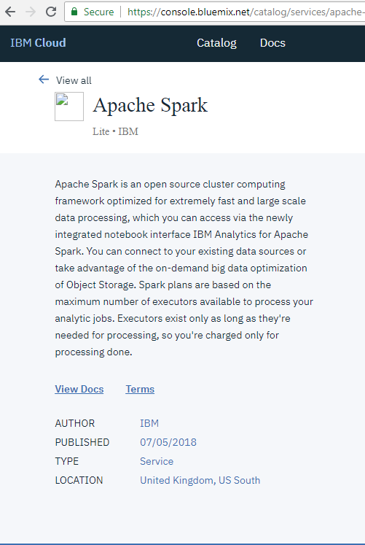

Slide 15
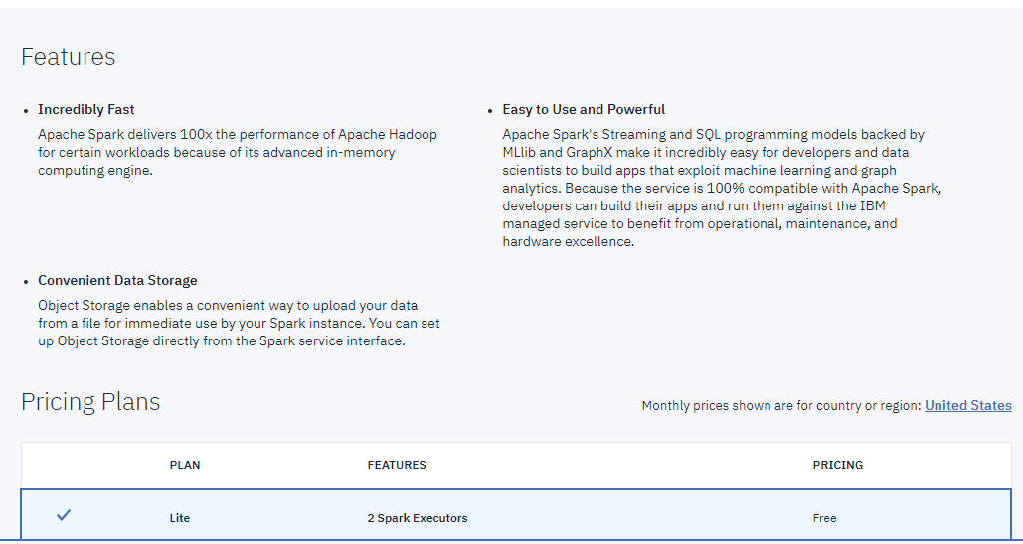

Slide 16
https://spark.apache.org/
Databricks – apache spark – cloud community edition

Slide 17
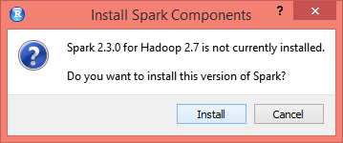
install.packages("sparklyr")

Slide 18
library(sparklyr)
library(dplyr)
spark_install(version = "2.3.0", hadoop_version = "2.7")
sc <- spark_connect(master = "local")

